Slide 1
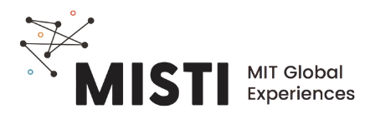
Sustainability and
Circularity in Fashion

Slide 2

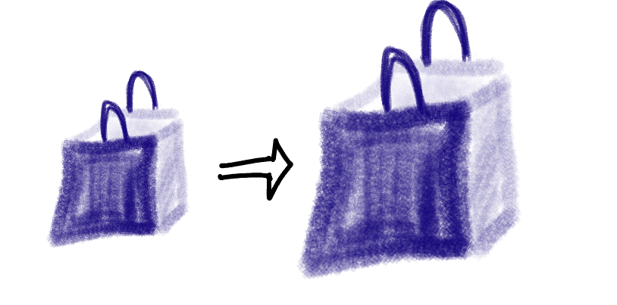
What Are Some Fast Fashion Brands?
Rapid turnover
High consumption
Traditional: 2 cycles per year
Typical fast fashion: 50 cycles per year
2000
2014
10
average number of wears before disposal
The average consumer bought 60% more clothing in 2014 than 2000, but kept each garment half as long.
Environmental Audit Committee. Fixing Fashion: Clothing Consumption and Sustainability, 2019.
Drew and Yehounme, Nature Climate Change, 2018.
https://www.wri.org/insights/apparel-industrys-environmental-impact-6-graphics
Notes:
https://www.sustainablejungle.com/sustainable-living/ethical-sustainable-fashion/
https://www.wri.org/insights/apparel-industrys-environmental-impact-6-graphics

Slide 3

Fast fashion is not sustainable
Less than 1%
of all clothing is recycled into new materials
Insert image of clothes in waste dump
Pie graph breakdown of the source of micro plastics in water (synthetic textiles are ~35%)
fashion contributes
10%
20%
of global carbon emissions*
of industrial water waste
McKinsey & Company, The State of Fashion, 2020.
https://www.wri.org/insights/apparel-industrys-environmental-impact-6-graphics
*more than aviation and shipping industries combined

Slide 4
Slowing down fashion: OSKLEN
Image highlighting the e-fabrics marketing of OSKLEN, a line of sustainably sourced materials.
https://www.osklen.com.br/efabrics
Notes:
https://www.osklen.com.br/efabrics

Slide 5
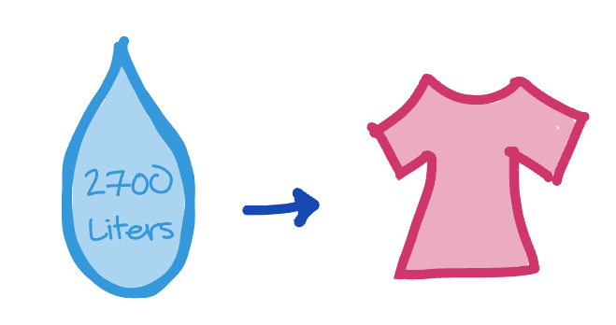
Shift to natural fibers
It takes 2700 liters of water to make one cotton shirt.
Image highlighting clothes made of jute and organic cotton (OSKLEN or elsewhere)
That’s the same amount 1 person drinks in 2.5 years.
https://www.osklen.com.br/efabrics
Notes:
https://www.osklen.com.br/efabrics

Slide 6
Recycling Other Products Into Fibers
Image highlighting use of recycled PET and cotton for textiles sources
https://www.osklen.com.br/efabrics
Notes:
https://www.osklen.com.br/efabrics

Slide 7
Resources and Articles
https://hbr.org/2022/01/the-myth-of-sustainable-fashion
https://www.mckinsey.com/~/media/McKinsey/Industries/Retail/Our%20Insights/The%20state%20of%20fashion%202020%20Navigating%20uncertainty/The-State-of-Fashion-2020-final.ashx
https://www.sustainablejungle.com/sustainable-living/ethical-sustainable-fashion/
https://publications.parliament.uk/pa/cm201719/cmselect/cmenvaud/1952/1952.pdf
https://thevou.com/fashion/fast-fashion/
https://www.nature.com/articles/s41558-017-0058-9#change-history
https://www.wri.org/insights/apparel-industrys-environmental-impact-6-graphics

